Slide 1
Working with GIT

Slide 2
Who am I?
Lahcen Zbair
Technical Expert at SQLI
Today: Solution Designer & Senior Developer at Nespresso
Animate GIT workshops and training, since its early days....
Working with GIT on multi projects since 2013 and still ...

Slide 3
Who are you?
Tell me about yourself
Did you already work on a GIT project
What's your expectations

Slide 4
Getting started
Documenation
Installation
Working with Command line (GIT bash, Commander, gitk)
GIT GUI (GIT Bash UI, TortoiseGIT)
IDE integration (EGIT, intellij GIT)

Slide 5
Getting started
Local environment setup
Project initialization
Project configuration
Quick look at GitLab
Notes:
~/.gitconfig (global por all projects)
.git/config (relative to a project)
git config –list
git config --global user.name "Lahcen Zbair" git config --global user.email lzbair@sqli.com

Slide 6
Version control with GIT
Stage files
Reset files
Commit changes
Revert commits
Pull and push
Ignore files
Track history
Notes:
git add
git reset
git commit
git revert
git status
# To see what you’ve changed but not yet staged
git diff
# To see what you’ve changed and already staged
git diff --staged
# This is the non verbose version, only the file names
git diff --name-status
# commits tree of a branch (prnets/child)
git log
# git transactions / commands done locally (regardless of the current branch), not shared –local only-
git reflog

Slide 7
Branch manipulation
Create / Delete branches
Upstream branches
Merge process
Rebase process
Merge requests
Notes:
reset branch to the last commit
git reset --hard HEAD
"git merge" creates a technical commit, unless no new commits (fast forward)
"git merge –no-ff"
Rebase cons:
- loose commits
- conflicts noise
- Ignore where commit comes from (Pull request) (same issue when fast forwarding)
- loose time ordering (also when fast forwarding)
- change hash of applied commit (cherry-pick like)

Slide 8
Merge request
Create local branch
Applu your change and commit
Upstream & Push local branch
Create a Merge Request
Waiting for review and approval
Rebase local branch, fix conflicts if any
Push & Merge local branch
Notes:
Resolve conflicts:
git mergetool

Slide 9
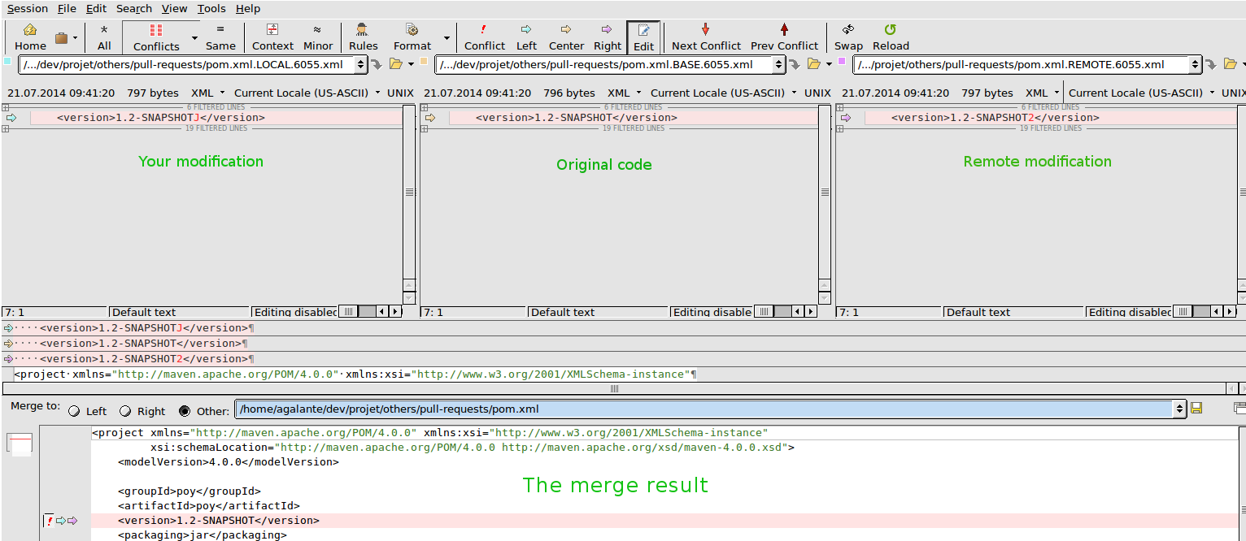
Notes:
Resolve conflicts:
git mergetool

Slide 10
GIT workflows
Bug fixing
Feature developemnt
Production patches

Slide 11

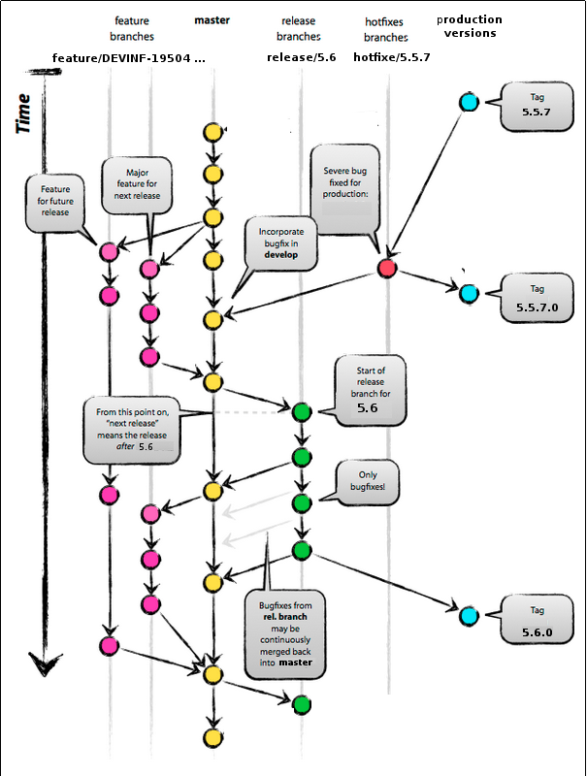

Slide 12
Additional topics
Usage of ssh keypairs
Interactive rebase
Tags
Multiple remotes
Forks
Notes:
git add
git reset
git commit
git revert

Slide 13
Good practices
Use Command line over GUI tools
Avoid global configuration as much a s possible
Commit as much as possile
Push less, while squatching commits
Prefer rebase over merge (except ...)
Use menigful commit messages

Slide 14
Good practices
Use "author" when commiting on behalf of others
Always share changes using merge requests
Rebase local branches, and merge into public branches

Slide 15
Bad habits
Create a project without (or with poor) "readme"
Stash changes
Rewrite history / Force push
Copy / Past a file to change location
Forget to delete unused / old branches
Cherry pick commits (except ..)

